Slide 1
Section 11.1
Conics
Copyright © 2012 Pearson Education, Inc. Publishing as Prentice Hall.

Slide 2

Copyright © 2012 Pearson Education, Inc. Publishing as Prentice Hall.

Slide 3
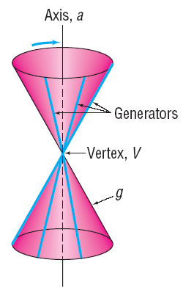
Copyright © 2012 Pearson Education, Inc. Publishing as Prentice Hall.

Slide 4
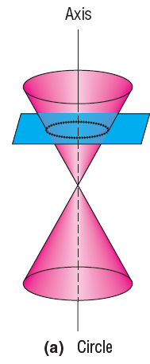
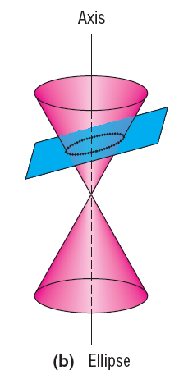
Copyright © 2012 Pearson Education, Inc. Publishing as Prentice Hall.

Slide 5
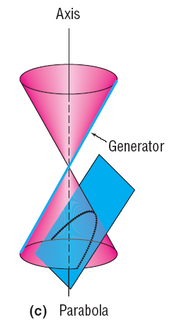
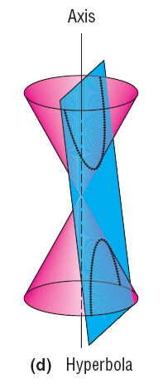
Copyright © 2012 Pearson Education, Inc. Publishing as Prentice Hall.

